Slide 1

HOTEL RESERVATION USING HIBERNATE AND MAVEN
Name: Harini Akshaya K
Enrolment No : EBEON1222698864

Slide 2
Team Members
Harini Akshaya(EBEON1222698864)
Pavithra (EBEON1222704165)
Guided by
Varadharajan (Trainer)
Supported and sponsored by
Edubridge India private ltd.
Capgemini India.
Vishnupriya (EBEON1222710971)
Sandhyadevi (EBEON12227110971)

Slide 3
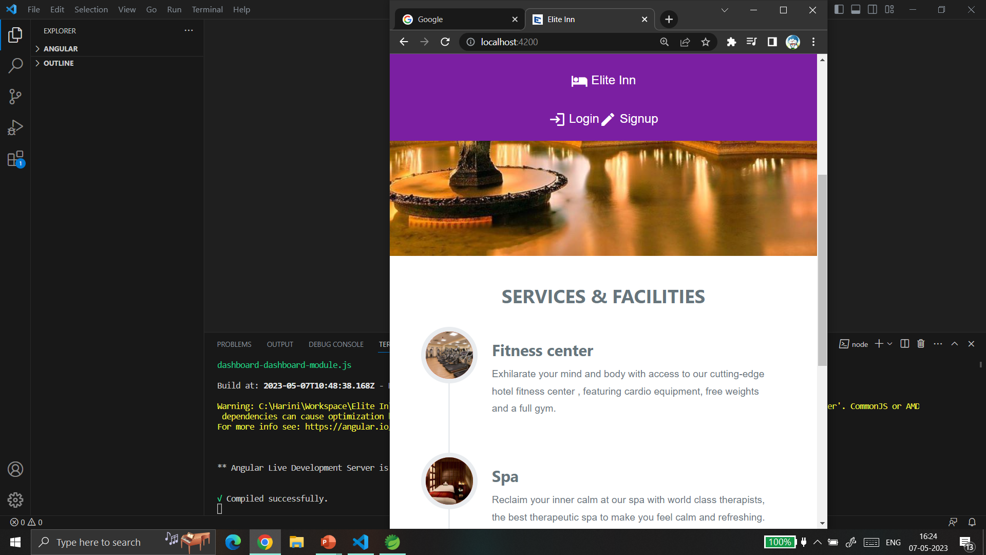
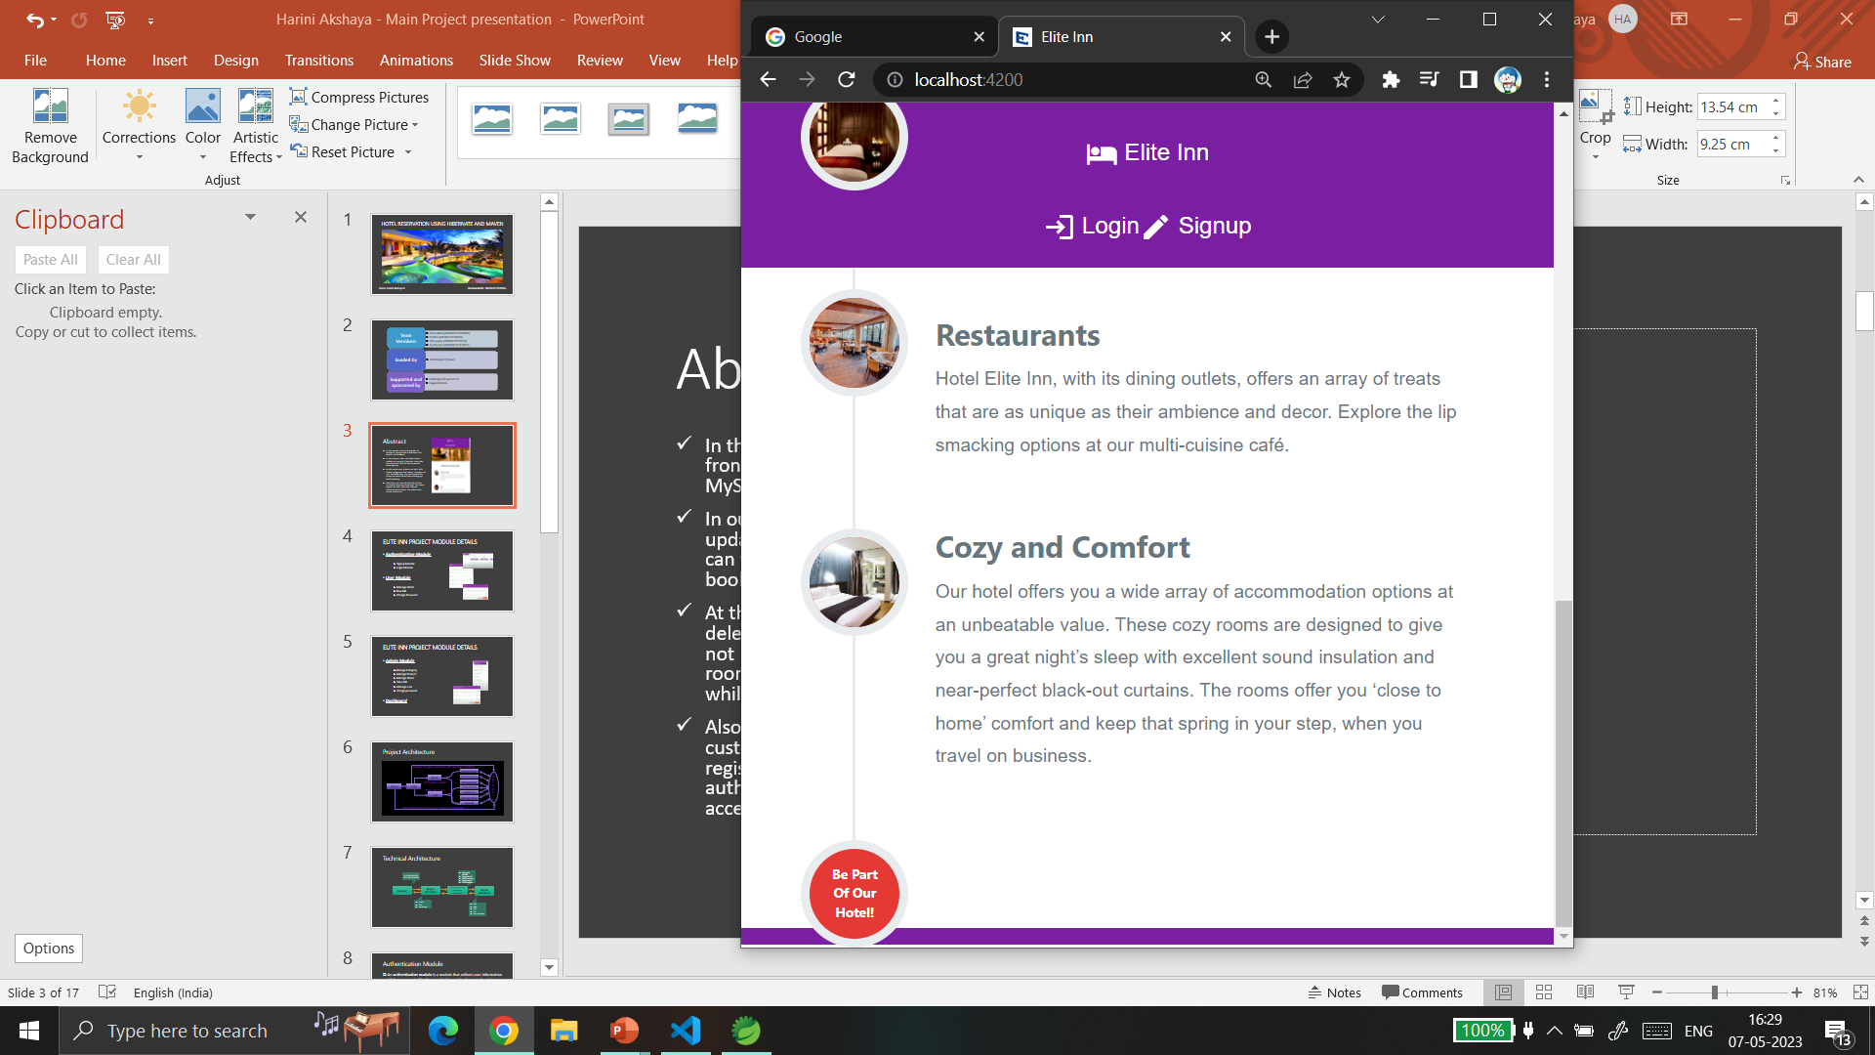
Abstract
In this project, we used Angular as frontend, spring boot as backend and MySQL as Database.
In our project, User can book rooms, update or cancel it if needed. Also they can view their bills of their previous bookings too.
At the same time, Admin can add, edit, delete categories and rooms. If rooms are not available they can also disable the rooms to avoid them from showing up while booking.
Also they can view all the bills of their customers previous bookings. For newly registered user, after the manual authentication admin can allow them access resources.

Slide 4
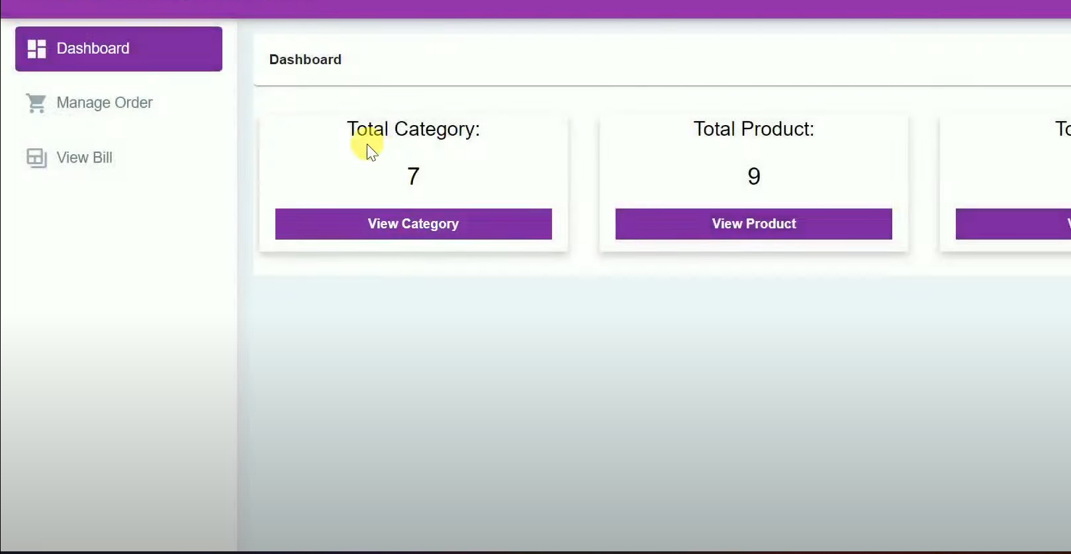
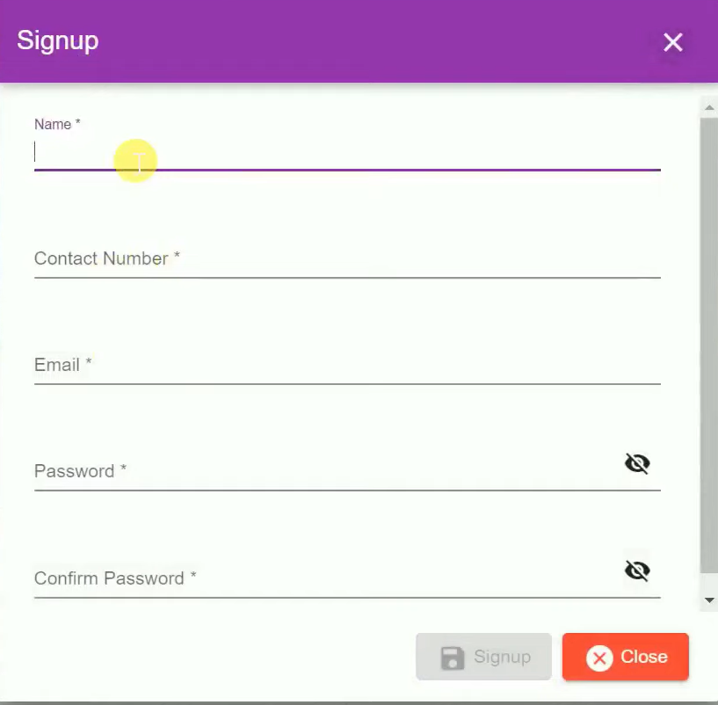
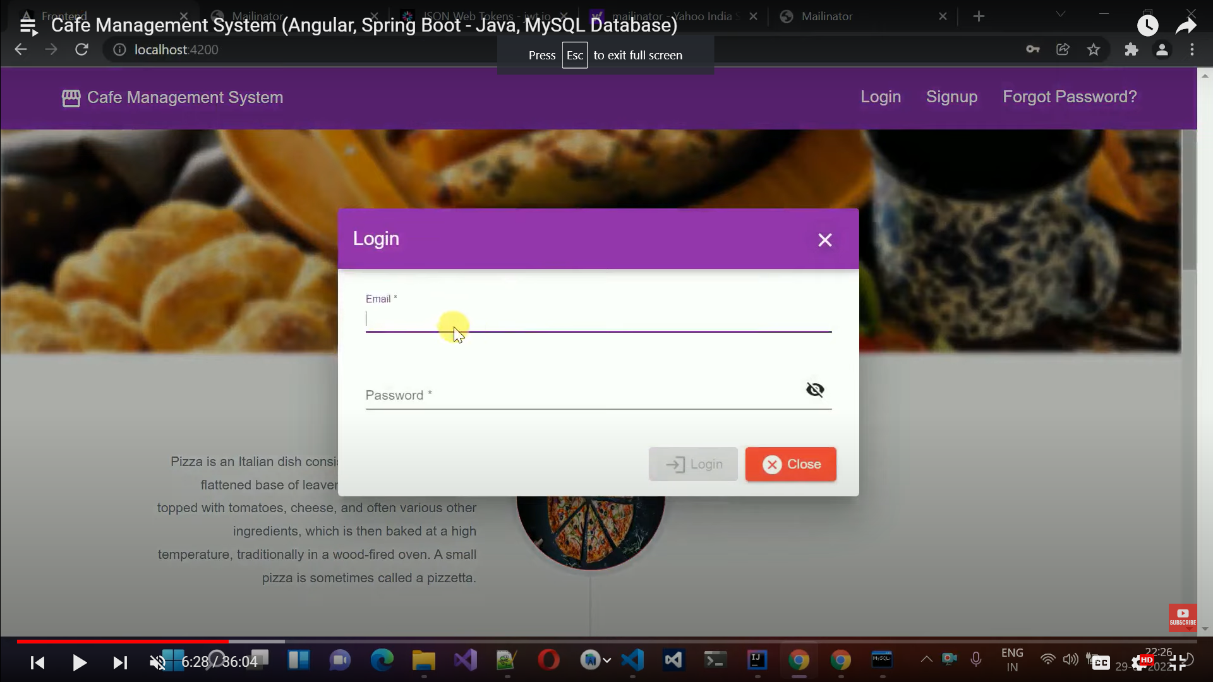
ELITE INN PROJECT MODULE DETAILS
Authentication Module
Signup Module
Login Module
User Module
Manage Order
View bill
Change Password

Slide 5
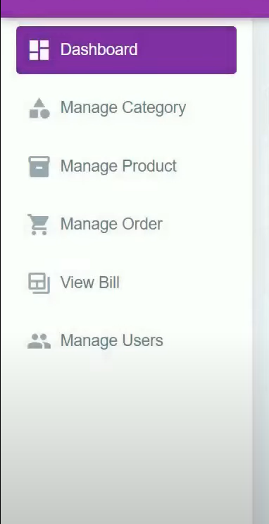
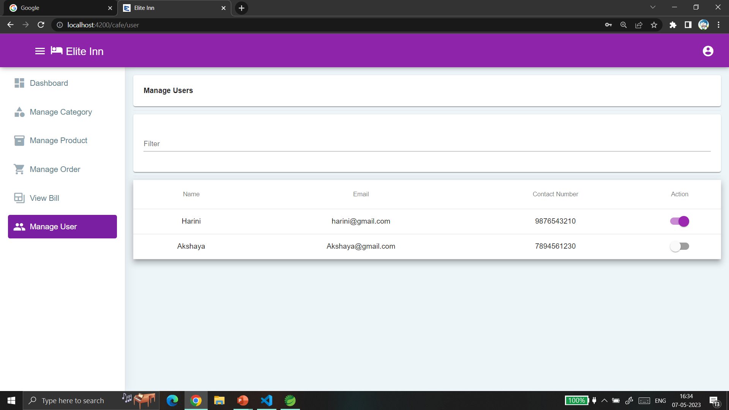
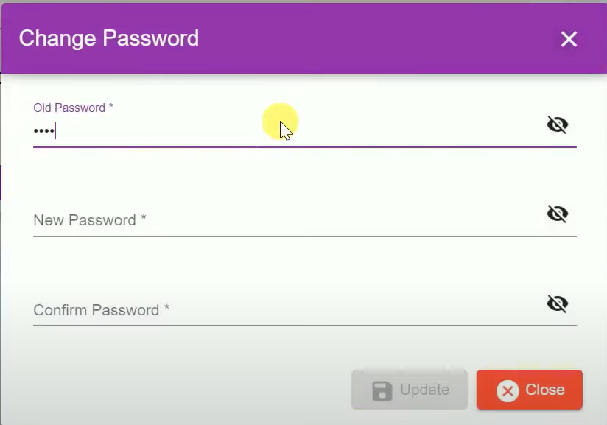
ELITE INN PROJECT MODULE DETAILS
Admin Module
Manage Category
Manage Product
Manage Order
View bill
Manage user
change password
Dashboard

Slide 6
Project Architecture
(Compare the given credentials with data in the database)
Manage Category
DA
T
A
B
A
S
E
Admin
Manage Product
(If the role is admin)
Manage User
Signup
Login
Change Password
( If the role is user )
User
Dashboard
Manage Order
View Bill
(Data obtained from the user was stored in the database)

Slide 7
Technical Architecture
HTTP REQUEST(GET, POST, PATCH,DELETE)
Spring web
Spring data JPA
MySQL connector
Spring Security
JSON web token
Browser
Angular
(Frontend)
Spring Boot and Hibernate
(Backend)
MySQL
(Database)
HTML
CSS
JavaScript
DDL
DML
DCL
TCL
Key concepts

Slide 8
Authentication Module
An authentication module is a module that collects user information which are requested by the organization or developer and register them into the database.
It also compares the information such as user id and password against entries in a database.
If a user provides information that meets the authentication criteria, the user is validated and, granted access to the requested resource.
If the user provides information that does not meet the authentication criteria, the user is not validated and denied access to the requested resource.

Slide 9
Sub modules (Signup and Login)
SIGNUP FORM:-
A signup form is a web page, popup, or modal where users enter the information required to access that website’s services. The information collected is determined by the nature of the website and the services it offers. Most signup forms require a name, email address, username, and password.
LOGIN FORM:-
A Login form is used to enter authentication credentials to access a restricted page or form. The login form contains a field for the username and another for the password. When the login form is submitted its underlying code checks that the credentials are authentic, giving the user can access the restricted page. If a user is not able to provide authentic credentials they will not be able to proceed past the login form.

Slide 10
BACKEND FLOW
Explanation:
If you click run spring boot application ,
The Tomcat server is Started and main application context is kicked off which in turn search for the classes annotated with @Configuration, initializes all the declared beans in those configuration classes, and based upon the scope of those beans, stores those beans in JVM, specifically in a space inside JVM which is known as IOC container.
After the creation of all the beans, automatically configures the dispatcher servlet(Front controller)
Then it went to DAO interface where we have JPA Repository(where it as In Built Hibernate method such as Find all ,save , Find by id ).
From JPA Repository it stores in Database and it get response in the form of JSON(Java Script Object Notation)it stores in Database and it get response in the form of JSON(Java Script Object Notation)

Slide 11
FRONTEND FLOW
Explanation:
Using Angular we have done Frontend.
Before Starting the Angular server we have to run Spring Boot Application. When the server is Started in Angular first it comes into index.html. In index.html there is an App root it went on app module and app Component . Ts (app.component.html , app.component.css).
After that we have create Subcomponent like best seller, dashboard, login, material-component, homepage, etc.,
By Using these subcomponent there is service class in that we have to give base url to connect backend.

Slide 12
Reference Output
Fig.2: Login popup
Fig.1: Signup popup

Slide 13
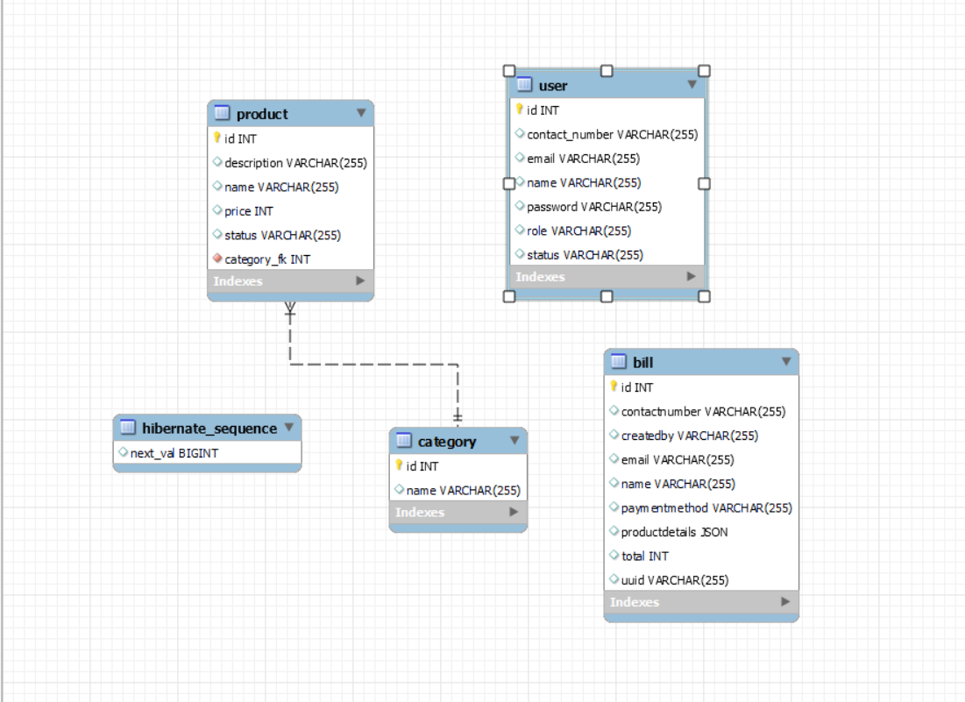
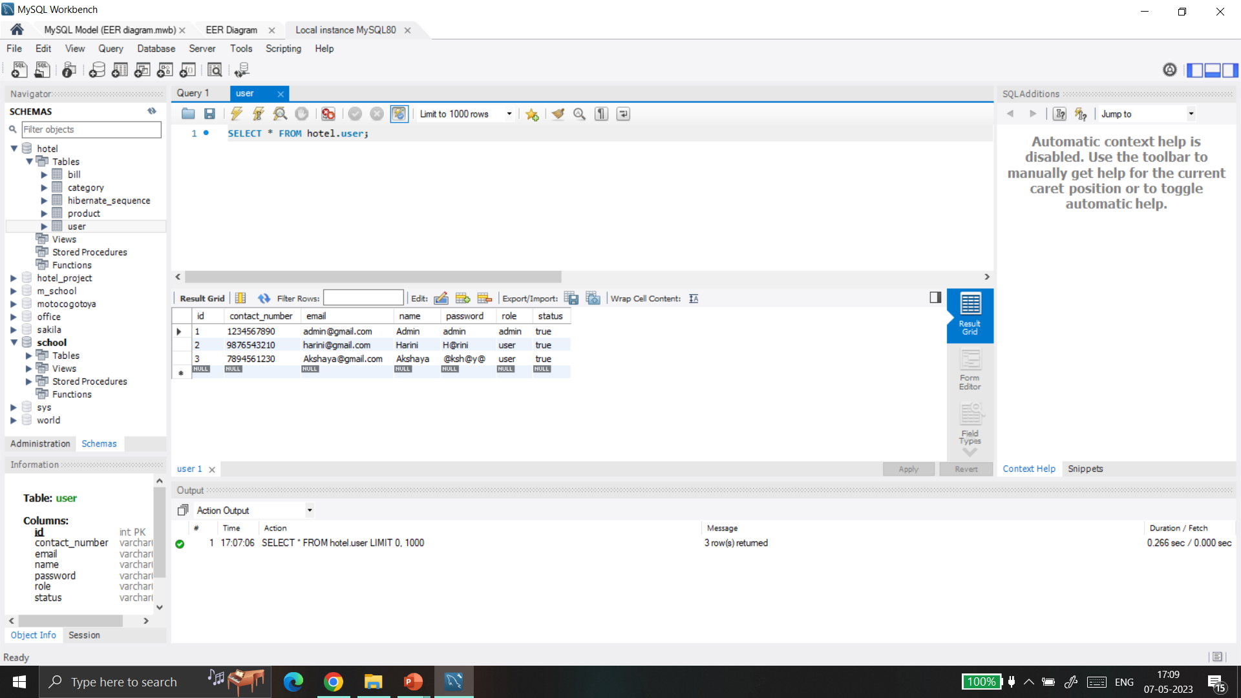
Reference Output
Fig.4: Table user
Fig.3: EER Diagram of our project database

Slide 14
Future enhancement
Try to send mail after successfully registered
Add forgot password module to change password if the user forgets it.
Add SSO(single sign-on) for authentication.

Slide 15
THANK YOU

